Slide 1
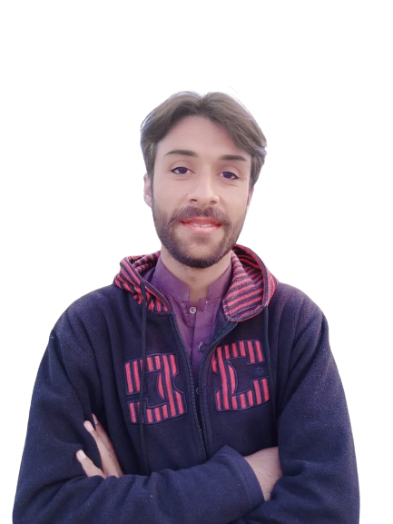
Intermediate Task Series
Problem Number 86

Slide 2
Problem Statement
Write a Desktop Python program to get first and last name from user to display full name to user.

Slide 3
Algorithm
Step1: Import a tkinter module
Step2: Create a basic window
Step3: Get first name and last name from user
Step4: Display a full name to user
END

Slide 4
Assignment
Write a Desktop Python program to get a number from user to display its cube.

